Slide 1
Theoretical and Experimental spectrum Alignment

Slide 2
Members:
Nada Magdy
Nada Abdelmohsen
Marwa Mahmoud sayed
Menna Talla Salah
Manar Ahmed Mohamed
Nada Naser

Slide 3

The fasta file of yeast that we use

Slide 4
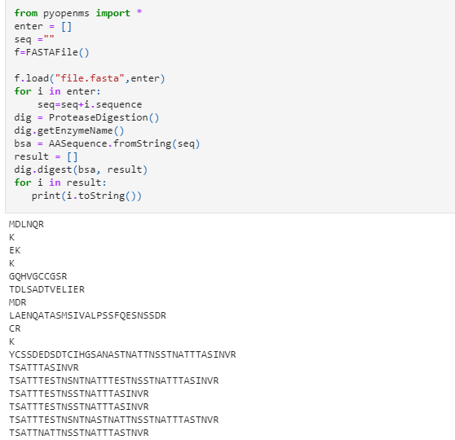
Digestion

Slide 5
fusion_180220-11.raw

Slide 6

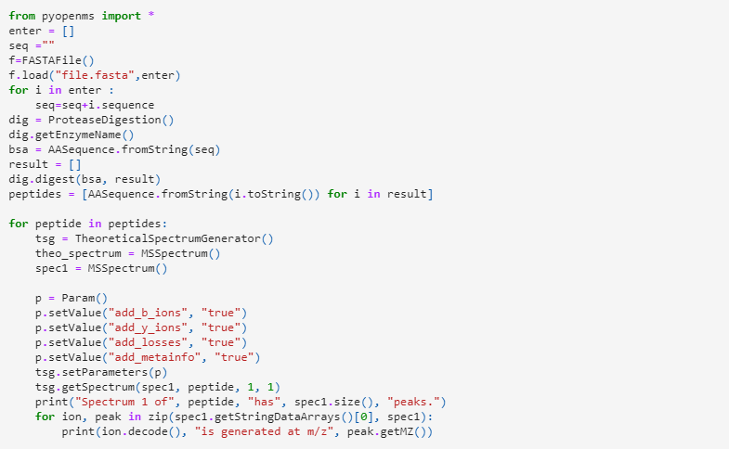
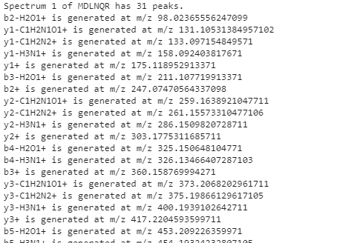
load mzml file and show spectrum peaks

Slide 7
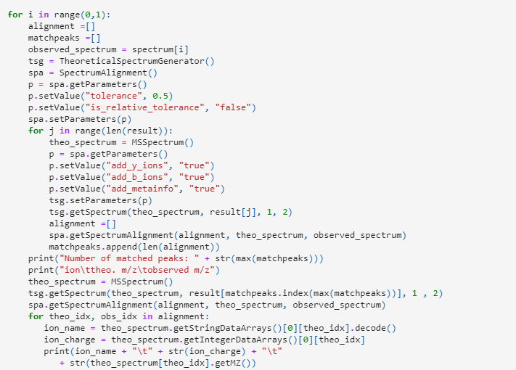

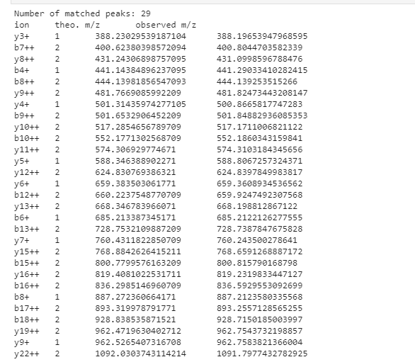
we print number of matched peaks

Slide 8

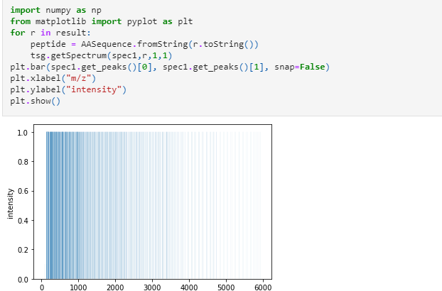
show the plot of spectrum and peptied sequence

Slide 9
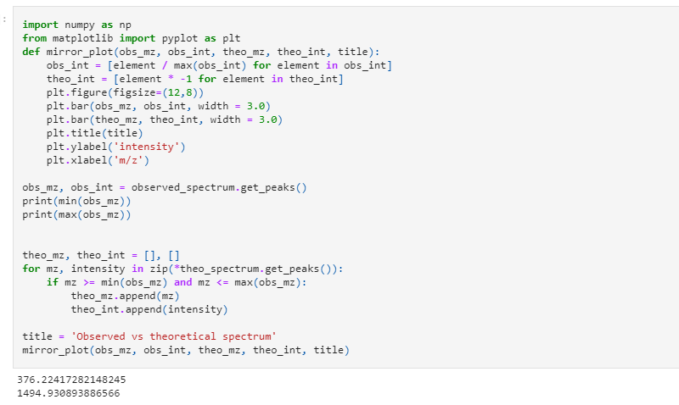
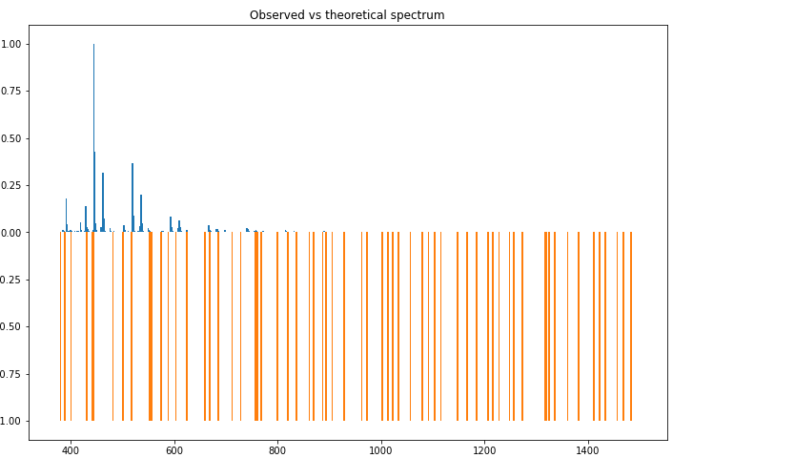
Observed vs theoretical spectrum mirror plot

Slide 10
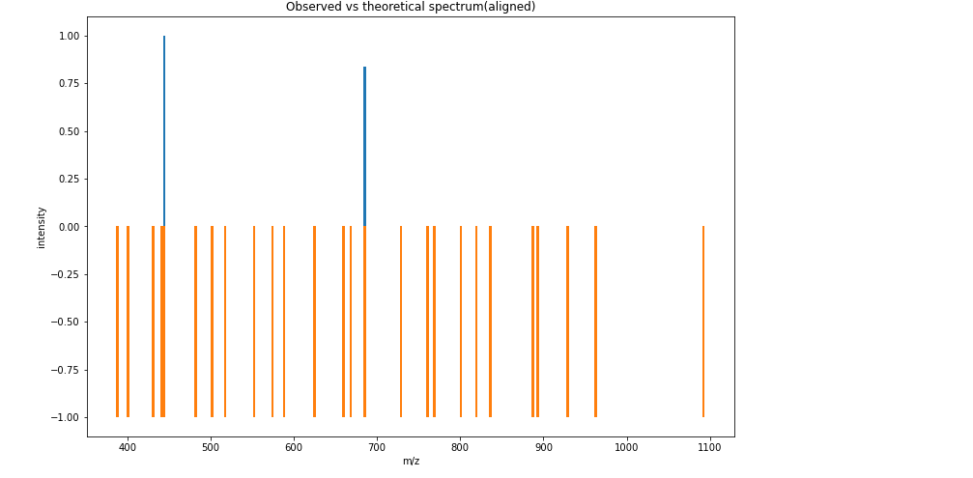
Observed vs theoretical spectrum aligned mirror plot

Slide 11
"Fusion_180220_10.raw"

Slide 12
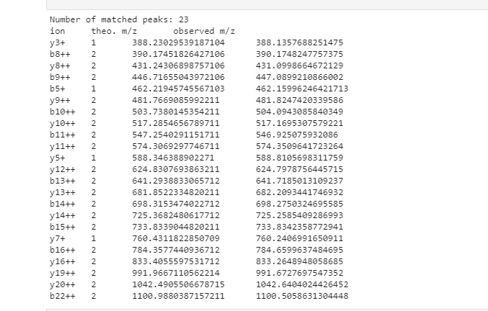


Slide 13
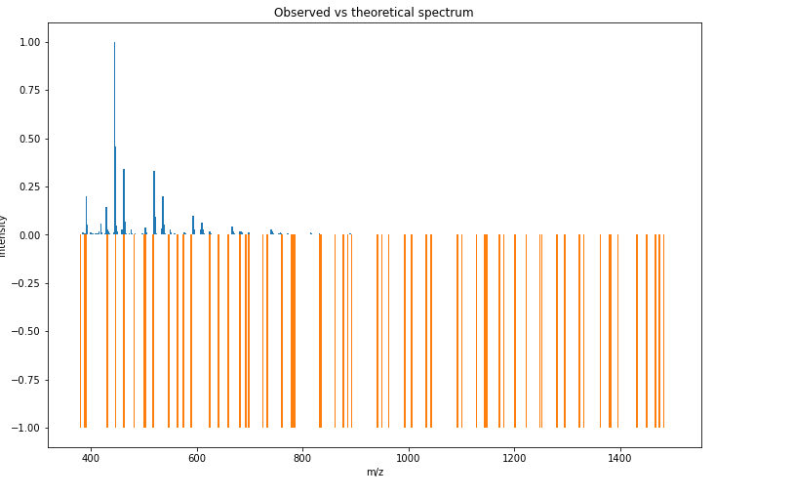
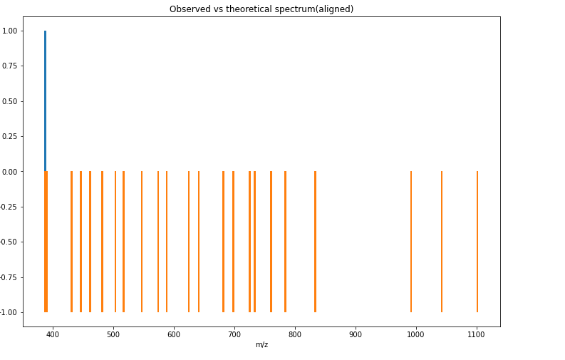

Slide 14
"Fusion_180220_23.raw"

Slide 15
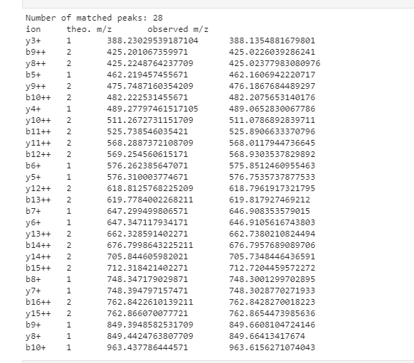


Slide 16
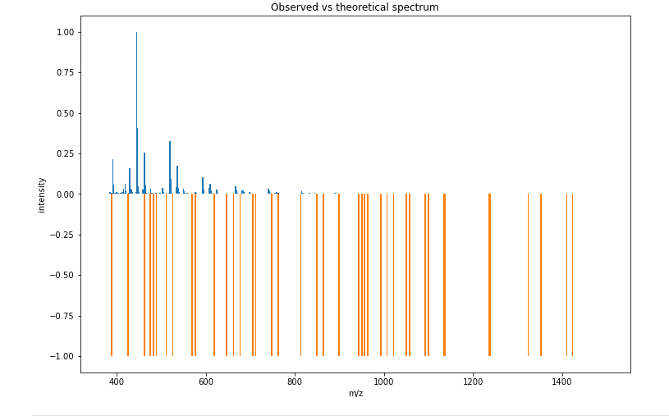
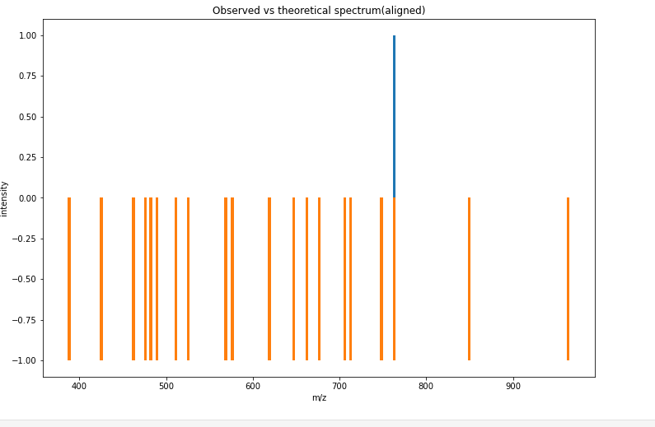

Slide 17
"Fusion_180220_08.raw"

Slide 18
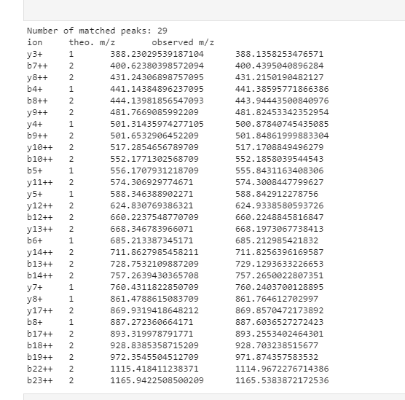


Slide 19
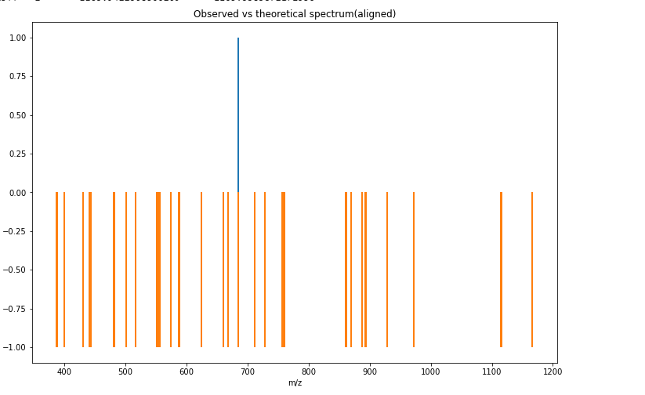
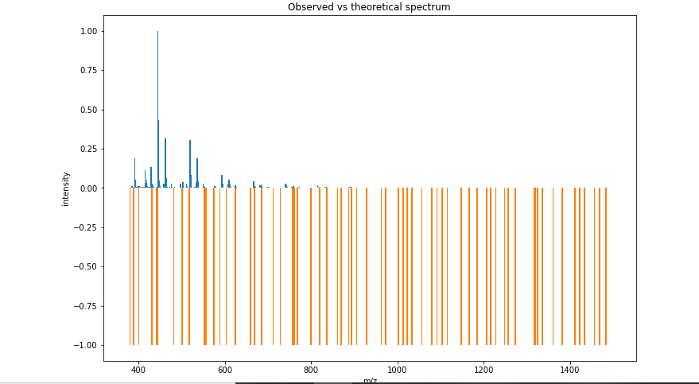

Slide 20
"Fusion_180220_37.raw"

Slide 21
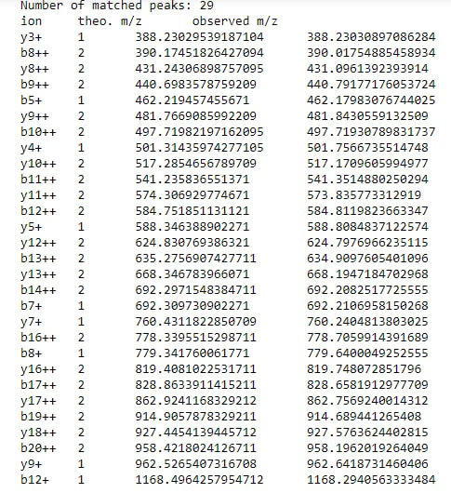


Slide 22
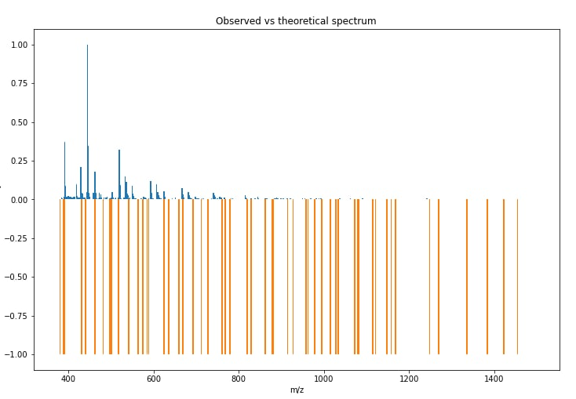
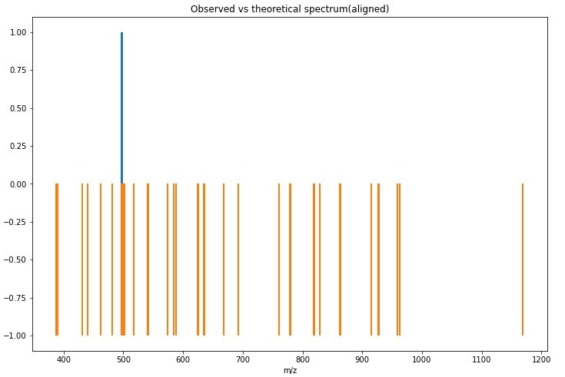

Slide 23
"Fusion_180220_40.raw"

Slide 24
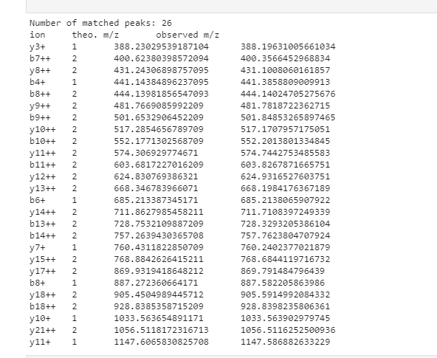


Slide 25
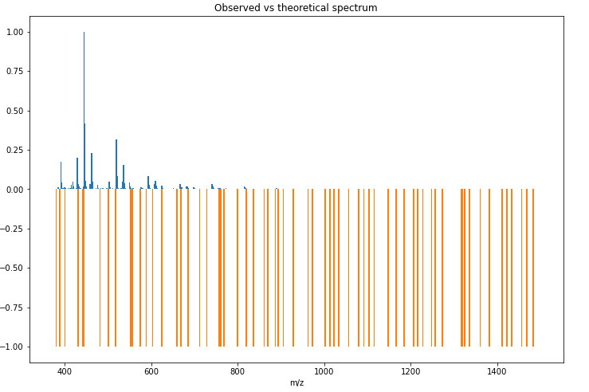
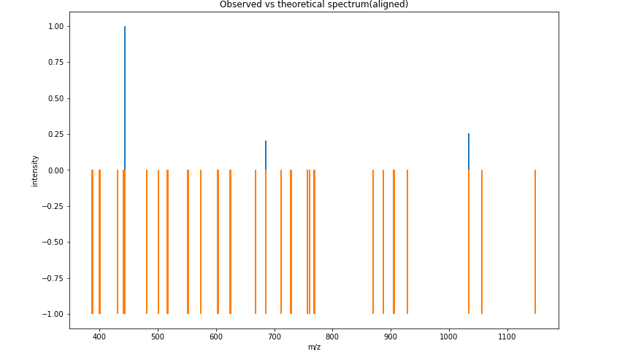

Slide 26
"Fusion_180220_38.raw"

Slide 27
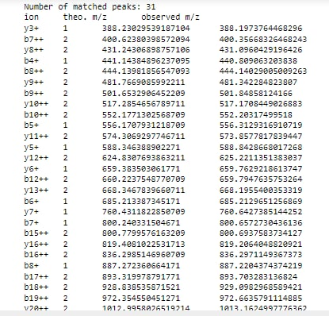


Slide 28
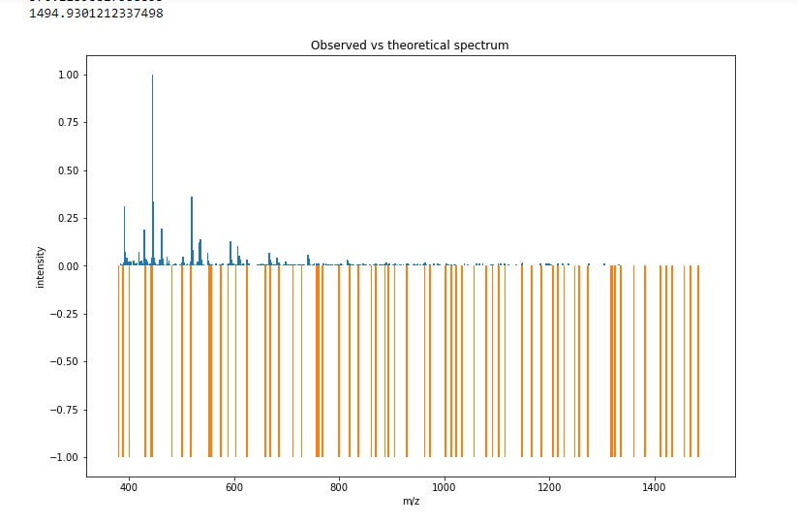
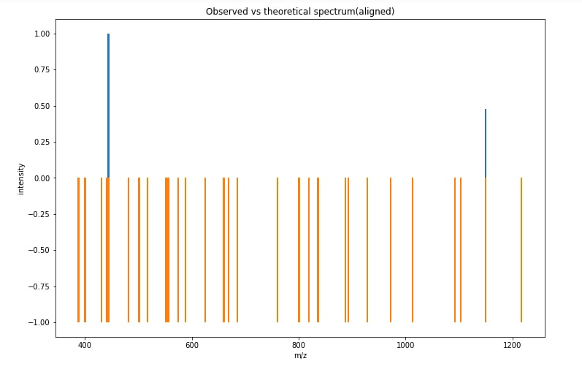

Slide 29
"Fusion_180220_09.raw"

Slide 30
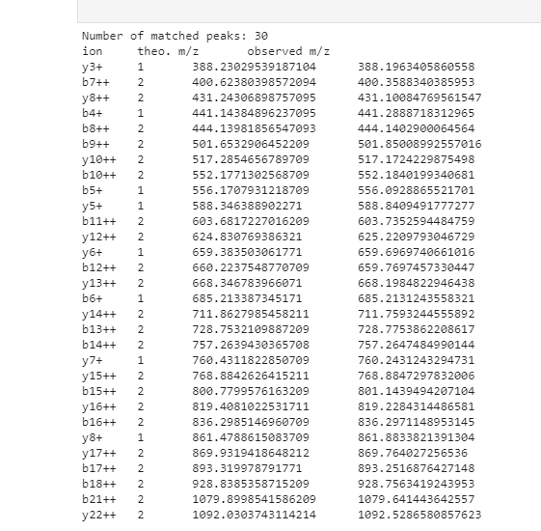


Slide 31
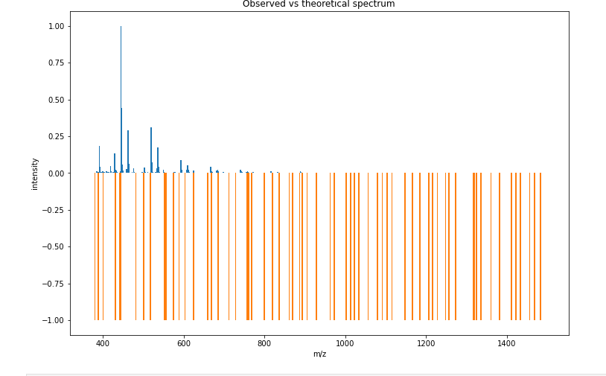
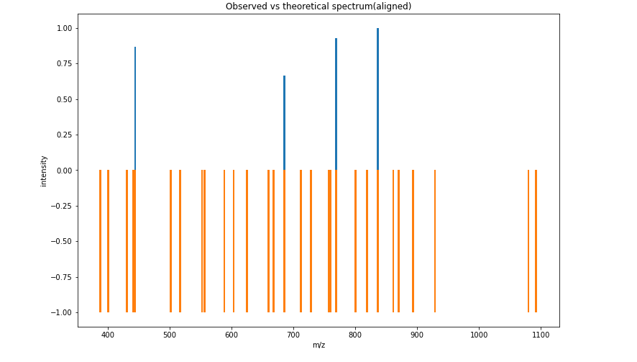

Slide 32
"Fusion_180220_30.raw"

Slide 33
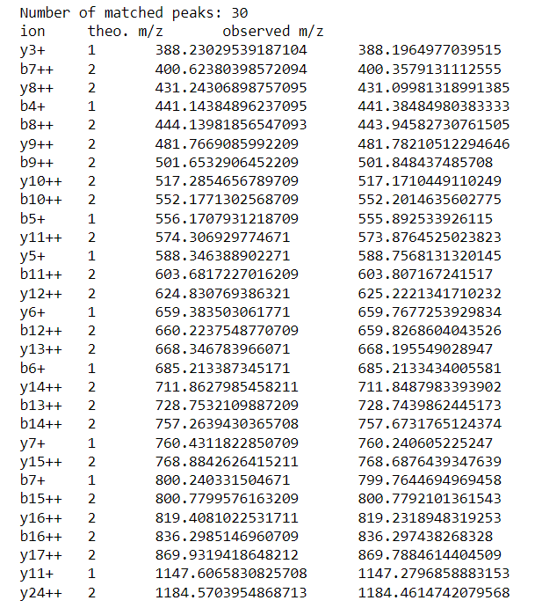


Slide 34
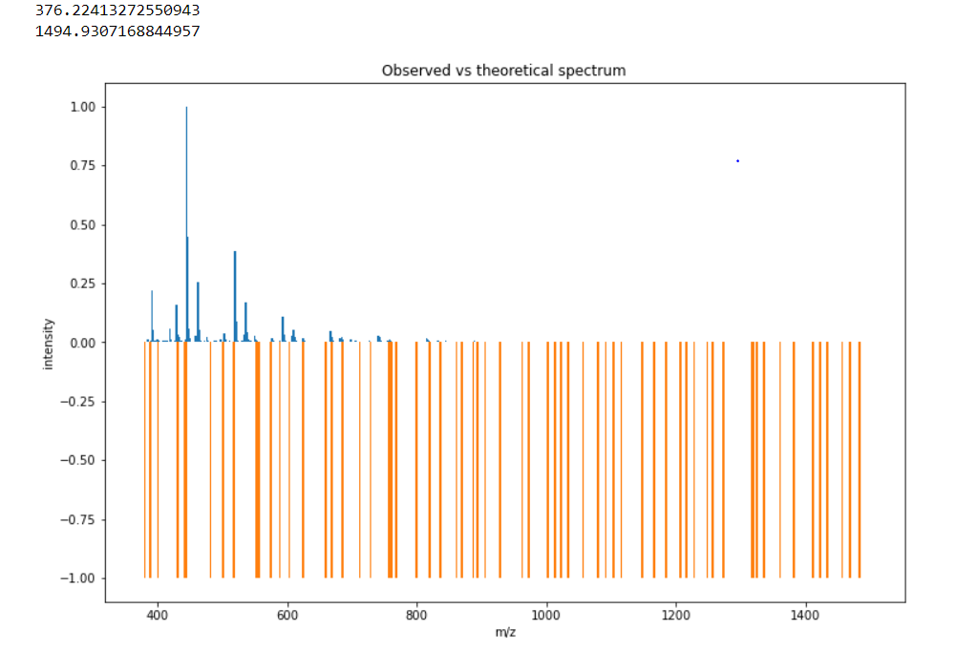
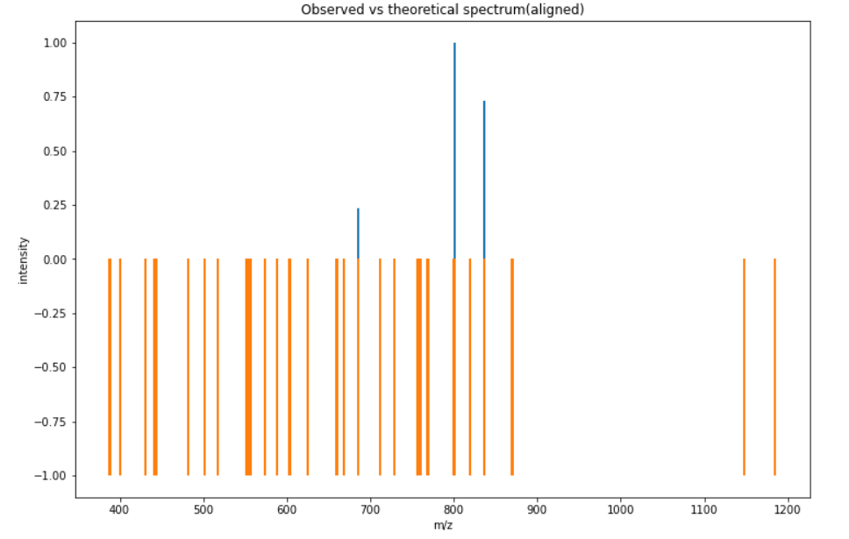

Slide 35
"Fusion_180220_41.raw"

Slide 36
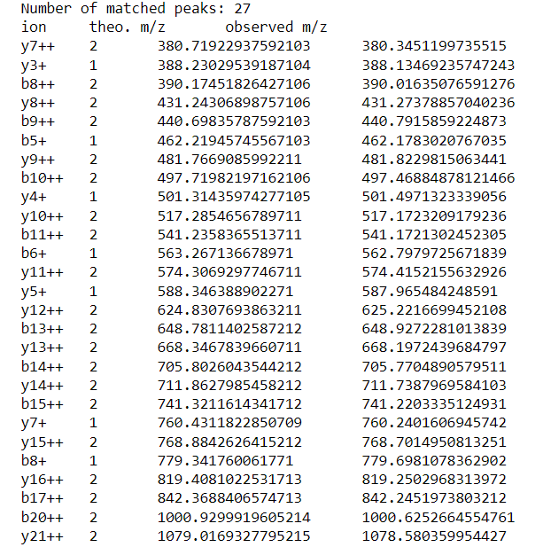


Slide 37
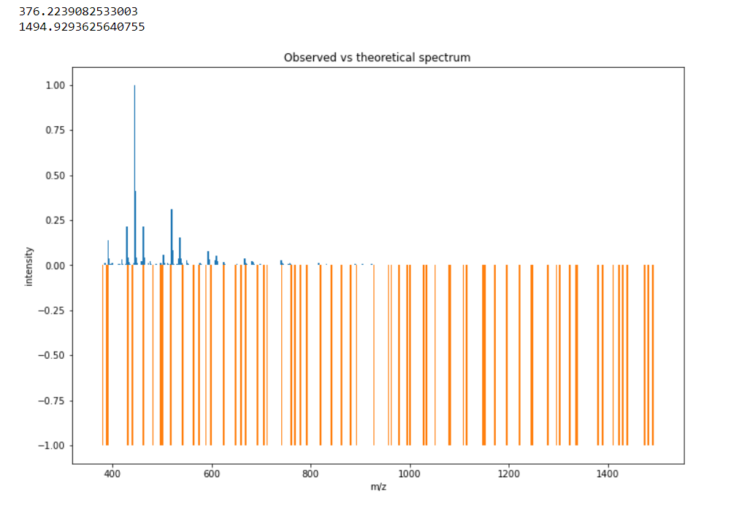
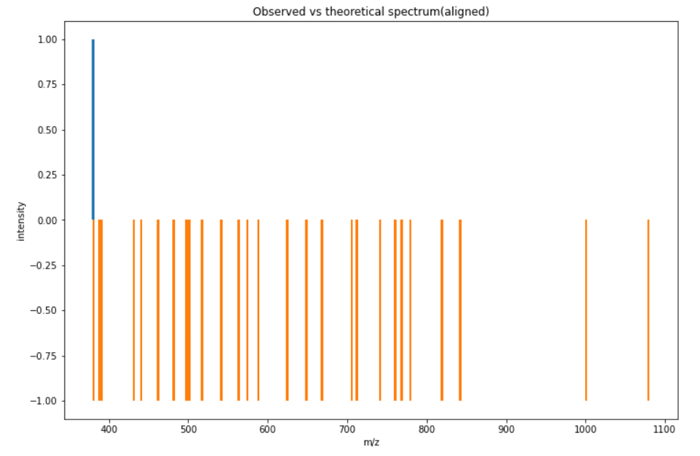

Slide 38
"Fusion_180220_42.raw"

Slide 39
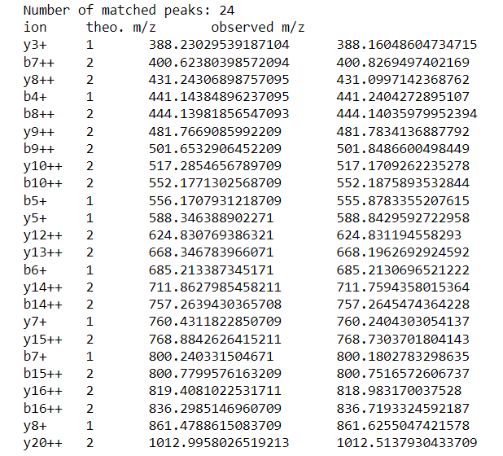


Slide 40
